Slide 1
Canon(izing)
Daniel Tompkins
Fall 2015

Slide 2
Basic goals of the program
Test a melody’s ability to be in counterpoint with itself given certain rules
Compare canon success rate of multiple melodies
Create scores that contain all possible combinations of given melody with itself.

Slide 3
Alterations to the melody
Transposition (diatonic and chromatic)
Offset
Prolation
Combination thereof

Slide 4
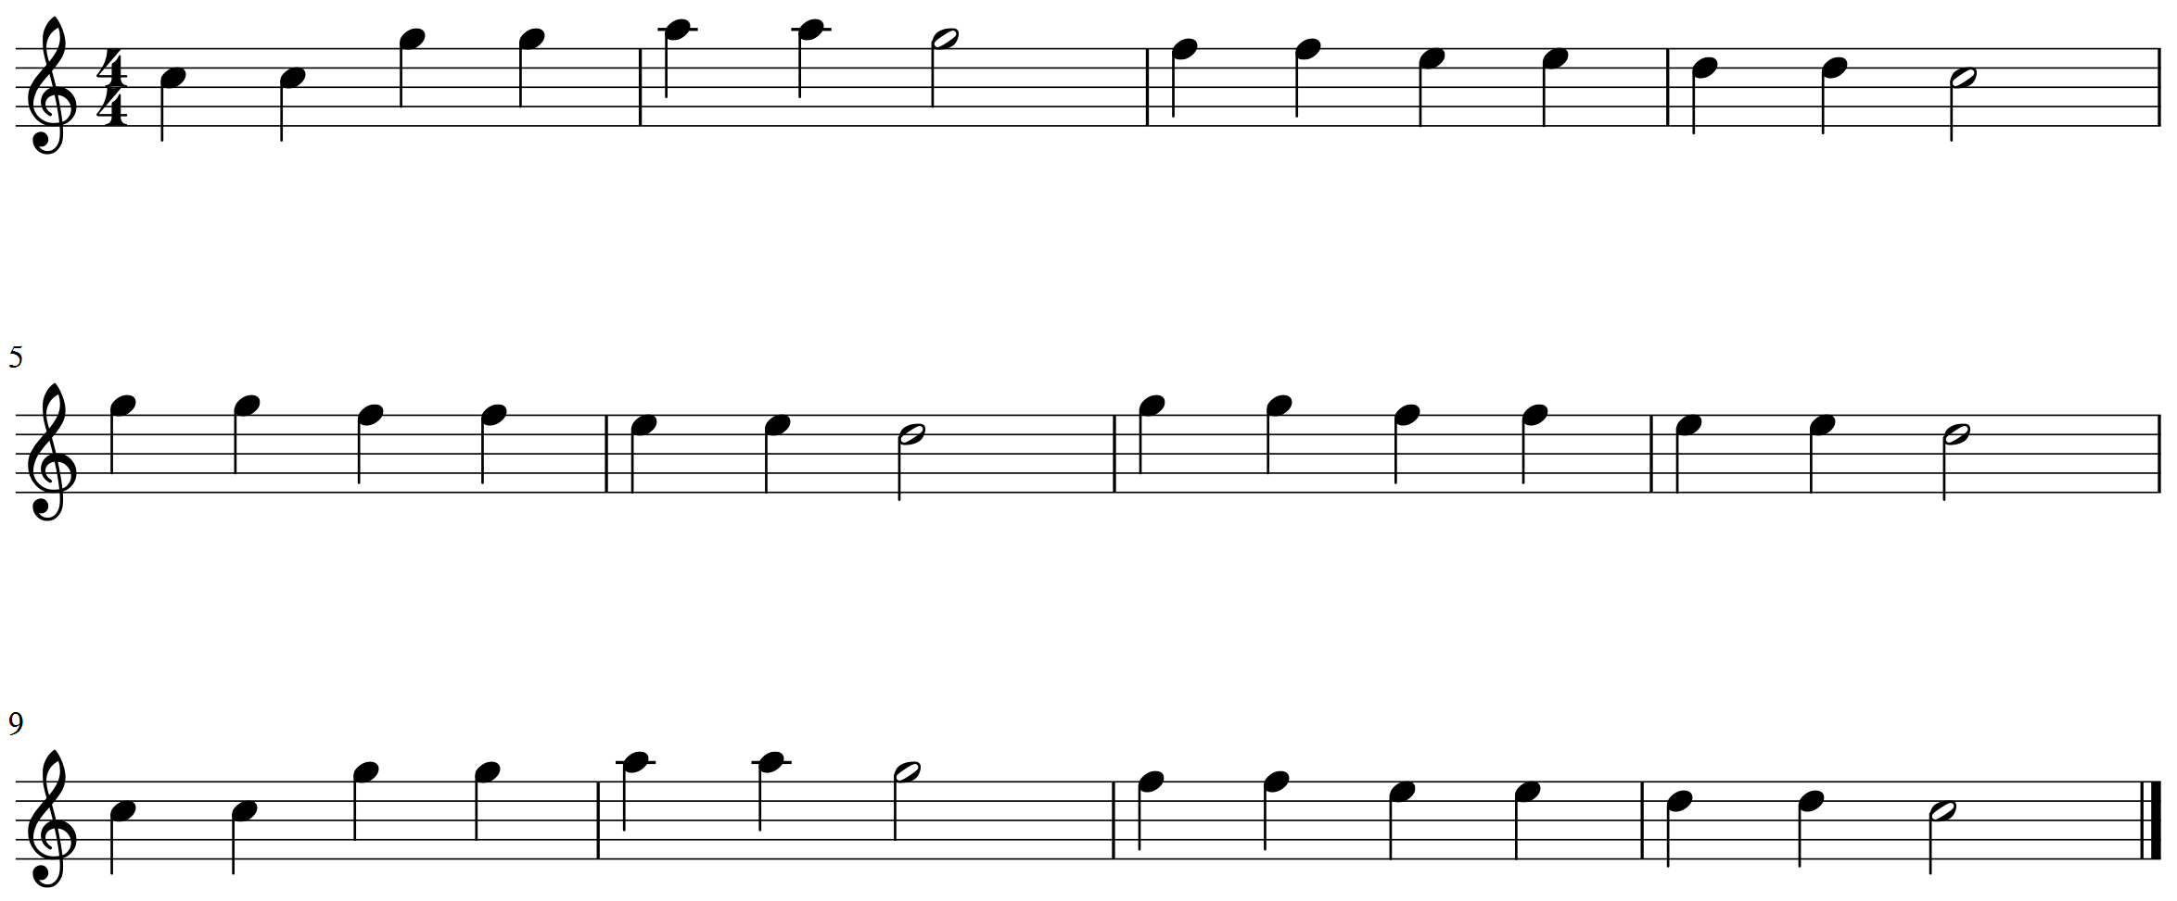
Begin with a melody

Slide 5
Combine it with itself
def score_maker(melody, function):
Combines the melody with an altered version of itself by creating a score with 2 parts: the melody and its alteration
The function is transposition, prolation, offset, or some combination

Slide 6
Diatonic transposition
def d_transpositions(melody, transposition):
Makes a deepcopy of the melody and transposes it the given amount (in pitch class numbers). The accidental is then adjusted to the given key.

Slide 7
Offset
def offsets(melody, offset):
Makes a deepcopy of the melody and adds a rest for the given duration (in quarter notes)

Slide 8
Prolation
def prolations(melody, time):
Makes a deepcopy of the melody; for each note in the copied melody, that notes quarterLength is equal to itself * given time.

Slide 9
Out with the “bad”
Test the created melody for counterpoint errors
Hopefully take out the “bad” combinations
Hopefully keep the “good” ones

Slide 10
Testing portion
Find the harmonic intervals of the 2-part score
Reject if forbidden parallels
Reject if dissonances do not resolve well

Slide 11
Finding the intervals
def intervalStream(element):
Takes the 2-part score and chordifys it. Find the interval by getting the absolute difference between the two notes of each “chord.”
%12 the intervals (optional)

Slide 12
Check for parallels
def parallel_checker(intervals):
Keeps a running tally of perfect fifths and octaves.
Optional arguments to reject too many parallel thirds and sixths
If the tally is above the set amount (strictness), it will reject the melody, else it will keep it.

Slide 13
Check for dissonances
def resolve_diss(intervals):
Gives a running tally of given offences and rejects the score if it’s above the threshold.
Things get a bit complicated if you don’t want to toss a good combination but still toss most or all bad ones.

Slide 14
Dissonances cont.
If two adjacent intervals are dissonant, add it to the checker. (this was the most successful loop to weed out the bad from the good, and keep the good)
If a tritione, resolve outwards or inwards. (this was also successful in pulling out the few bad left behind)
Optional: micromanage other dissonances (this more often tossed a good melody…)

Slide 15
Work in progress
I hope to find a clear way to check to see if a dissonance is a suspension, neighbor, passing, etc. and to know the difference between one voice moving and both voices moving (learning attack vs sustain, not possible with chordify method) …and compound melodies?
Music21 has some modules in process that could potentially do this work too, but it also seems to be stuck in figuring out the balance between being too liberal and too micromanaging with dissonances.
This becomes much easier if testing species counterpoint (of course).

Slide 16
Test a particular combination
def tester(melody, function, amounts, dict):
Tests a single function, given a list of amounts (such as transposition and a list of transpositions)
Creates a score for each item in the amounts list with the melody, then chordifys each melody for testing
Runs parallel_checker and resolve_diss. If they both return True, it passes.
Prints a dictionary that records what amounts worked.

Slide 17
Test multiple combinations
def multi_tester(melody)
Given global amounts for transposition and prolation, combine those with offsets that will go up to the halfway point of the melody
Run all of those through same tests
Gives percentage success and/or number of successful canons

Slide 18
Another feature of multi_tester
Creates a score that combines all of the successful canons (or the opposite, I suppose).

Slide 19
Canon success!
Show the canon success:
No prolation
Only adjacent dissonances, bad tritone resolutions and forbidden parallels tossed.

Slide 20
Canon fail!
Reverse that…

Slide 21
Test many melodies
def comparison(songs)
For folder of .xml files, test all of the files in multi_tester.
Keep a dictionary that records each melody and its success in percentage or number
Create a histogram of the data using pylab and numpy.

Slide 22
Things to do with that data
I made a “similarity” module that tests various parameters (I used 48 fugue subjects from Bach’s WTC 1&2).
Checked Pearson’s R for various things (see images if time).

Slide 23
Problems and what to do
As Cuthbert mentioned, the biggest problem is finding which questions to ask. It’s difficult not to find results trivial or mundane.
As a creative tool, this is very useful.
It is also very useful to see how important or not certain rules are at catching bad melodies. (this felt a lot like parenting…)

Slide 24
Moving forward
For possible dissertation…
I want to figure out the likely continuo harmonization given a bass line using realized figured bass by Kapsperger
Likewise, I want to look at the differences between harmonization by instrument (theorbo vs guitar vs keyboard).
And of course, I want to look at the abysmal voice leading on the realized guitar parts and ask why it was allowed only for that instrument.

